Slide 1

Python Programming
Jaewoong Han
Machine Learning &
Control Systems Lab.

Slide 2
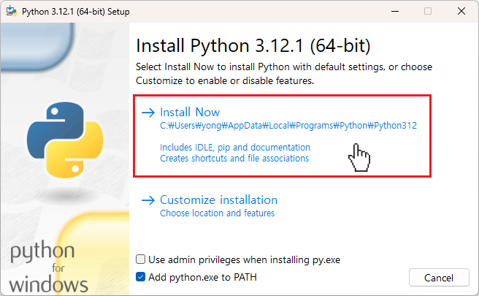
Basic
Install Necessary Programs
Python
https://www.python.org/downloads/
Choose latest version or appropriate version. (Recommend 3.8 upper)
Visual Studio Code (VSCode)
https://code.visualstudio.com/
It’s most popular open-source code editor.
Anaconda (not now…)
https://www.anaconda.com/
It is useful when you use virtual environment.
CUDA, cuDNN for using GPU (recommend, but not required)
https://pytorch.org/get-started/locally/
Find appropriate CUDA, cuDNN version for your computer
https://en.wikipedia.org/wiki/CUDA

Slide 3
Basic
Python coding you should study on your own
Data Structures
List, Tuples, Dictionaries, …
Control Structures
if, elif, else
for, while
Functions
Define functions, parameters, return, …
Object-Oriented Programming (OOP)
class class_name(father_class_name):
super(class_name, self). __init__()
Error Handling
try, except, finally
raise valuerror, …
Modules and Packages
pip install ~
from ~ import ~

Slide 4
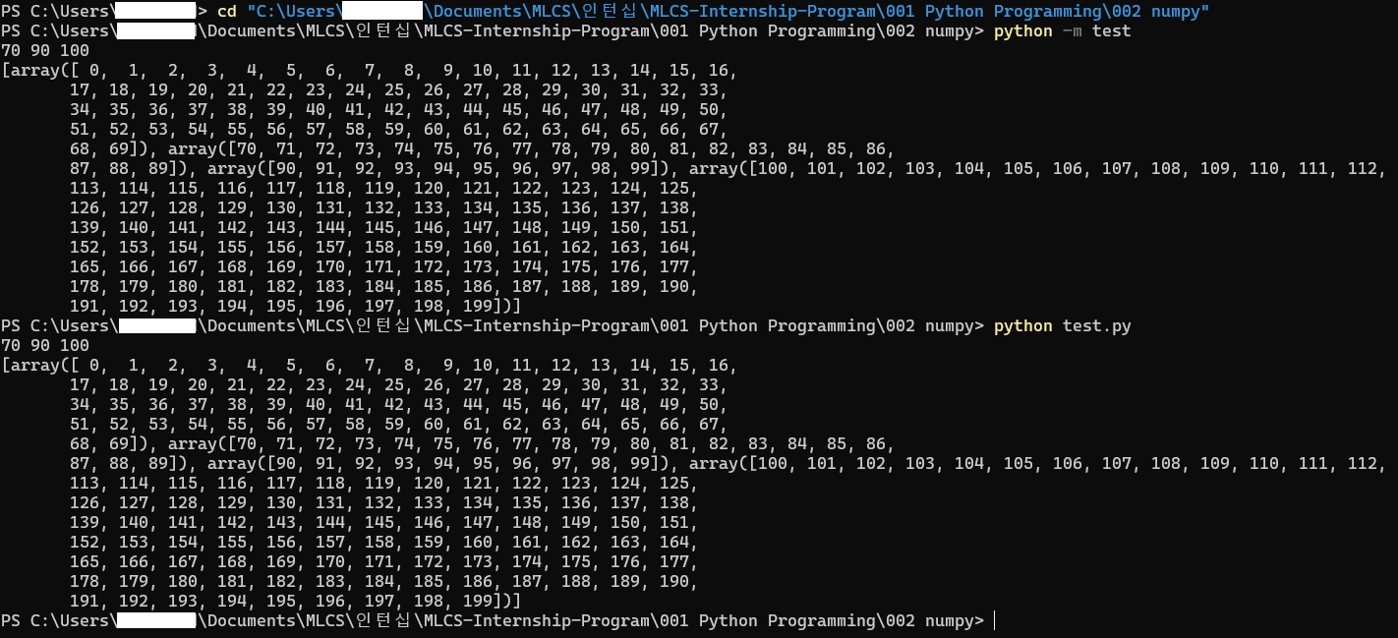
Basic
How to run a Python file using Command Prompt (cmd)
Module Path (prefer)
File Path

Slide 5
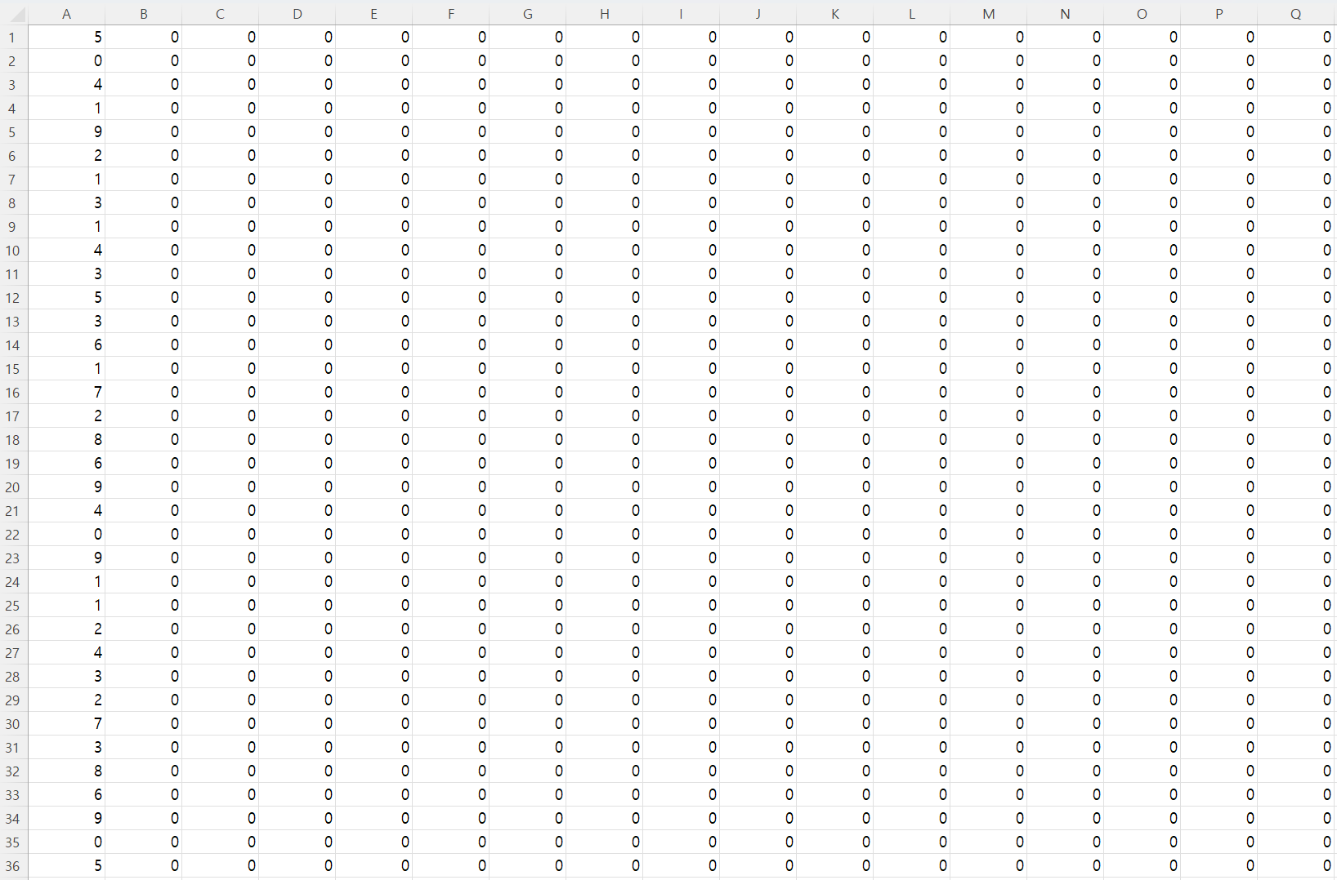


001 CSV
Handling csv files
Reading and writing csv files is one of the basic functions that we use a lot when dealing with data. In this course, we are going to read the MNIST dataset in the form of 1D vector and convert it into 2D vector form.

Slide 6
001 CSV
Load files
It is preferred to use relative paths in most cases
Use ‘os.path’ library instead of using string path

Slide 7
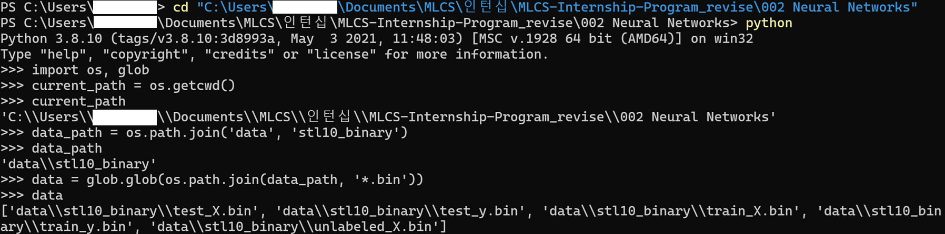
001 CSV
Load files
‘os.path.join’ creates path.
‘glob.glob’ returns the files in given pathB but note that the files are not sorted.

Slide 8
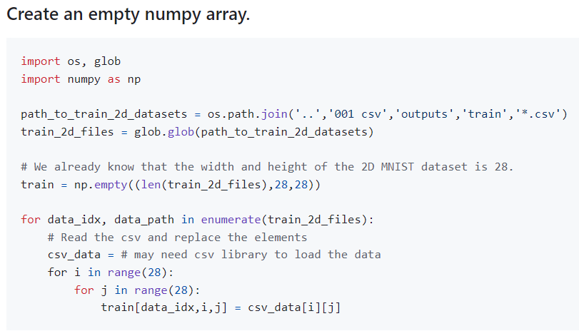
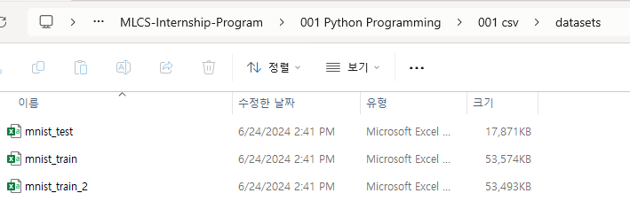
002 Numpy
Using Numpy Library
Using numpy library to treat numerical data in matrix form will be a daily job when you become a data scientist.
In this course, we are going to read 2D MNIST dataset (from the previous course) as numpy arrays.
Subsequently, we will split the data into train, validation, and test dataset and save those files as .npz files.
Our current directory is
… /MLCS-Internship-Program/001 Python Programming/002 numpy
We need to load train datasets in
… /MLCS-Internship-Program/001 Python Programming/001 csv/ ~

Slide 9
Question

